Slide 1

2017 Devon IT Hackathon
Danny.Burrows
Don.Morrison
Steve.Pankratz
Jon.Slominski

Slide 2

Tools
.NET Core / .NET Standard
Azure Event Hub
Azure Search
Azure ML Studio
Azure Storage
Angular
Serilog
Application Insights
Visual Studio Team Services
Slack

Slide 3










Flow
Engineering limits
Azure SQL
BI/Reporting
PI Historian
Contracts
Pump Schedule
Event Hub
Event Hub
Responsive Web App
Streaming API
Addl. Data Integrations
Azure Stream Analytics

Slide 4
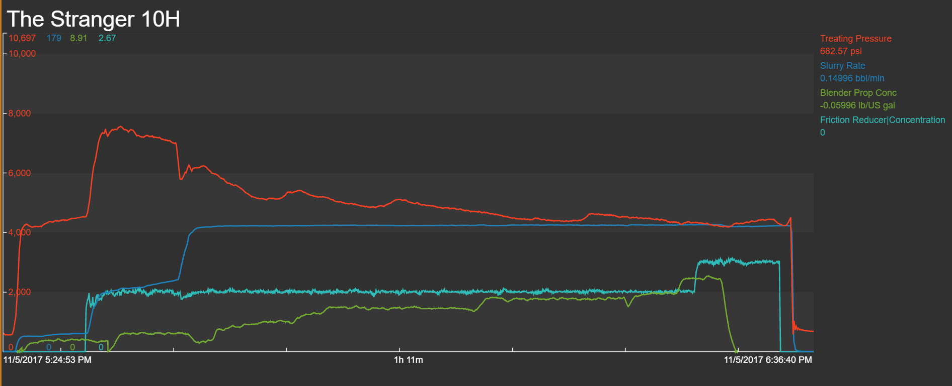
Demo

Slide 5
Summary

